Slide 1
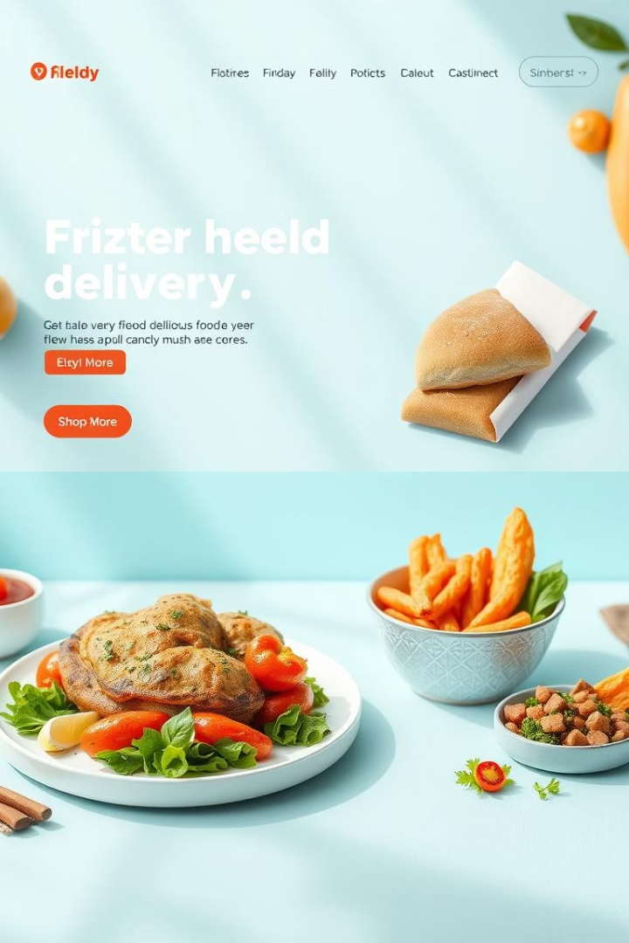
Modern Food Delivery UI/UX Design
Create a seamless food ordering experience with bold visuals, user-friendly navigation, and responsive design. This UI/UX concept balances appetizing food photography with clear CTAs and minimalistic cards to boost conversions and delight customers.

Slide 2
User Interface: Home & Browse Restaurants
Home Page
Browse Restaurants/Menu
Features a welcoming hero image with top restaurants and personalized recommendations. The warm palette creates hunger appeal while modern typography ensures readability.
Displays clean, card-based menus with filters for cuisine, dietary restrictions, and ratings. Users can quickly add items with bold “Add to Cart” buttons.
Grid layout for easy scanning
Search bar with predictive text
High-quality food photos
Featured restaurant cards with photos
Mobile-friendly touch targets
Prominent “Browse” CTA buttons

Slide 3
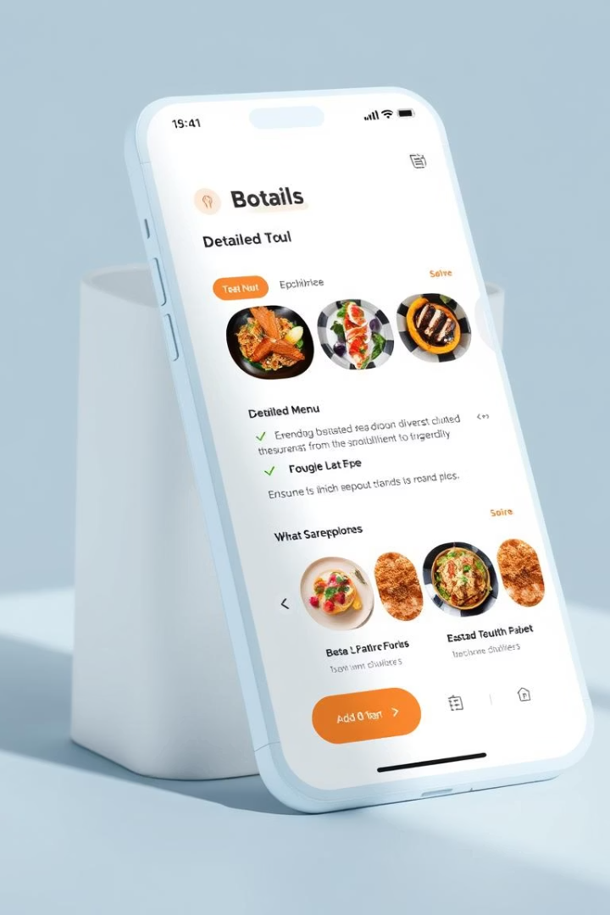
Restaurant Detail & Cart Interaction
Restaurant Detail
Clean layout emphasizing food images, reviews, and menu categories. Sticky “Add to Cart” CTAs improve conversion flow.
Cart Page
Minimalistic card design with clear item breakdown, quantity controls, and total price summary. “Checkout” buttons stand out in bold colors.

Slide 4
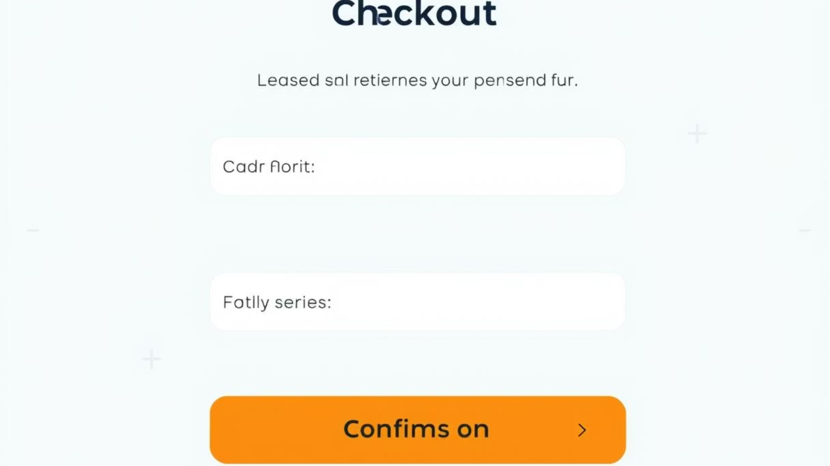
Checkout & Order Confirmation
Checkout Process
Order Confirmation
User-friendly form with saved address options
Clear confirmation message with order summary
Multiple payment methods visual icons
Estimated delivery time displayed
Progress indicators for checkout steps
CTAs to continue browsing or track order

Slide 5






User Account & Order Tracking
Order Tracking
Real-time progress bar with clear delivery status, interactive map, and prominent “Contact Driver” and “Help” buttons.
User Profile & Dashboard
Displays past orders, saved addresses, and preferences in a minimalist card layout for quick access and updates.
Help & FAQ
Intuitive search, categorized FAQs, and easy access to support through chat or phone. Minimal icons guide users clearly.

Slide 6


Admin Interface: Login & Dashboard
Admin Login
Dashboard
Secure and streamlined login screen with minimal fields, brand color highlights, and feedback for failed attempts.
Overview cards displaying orders, revenue, and user activity. A clean grid layout highlights key data visually.

Slide 7




Admin Management Tools & Analytics
Order Management
Filterable order lists with quick status updates and batch actions, designed for efficiency.
Menu & Restaurant Management
Easy-to-edit menu cards and restaurant profiles with drag-and-drop ordering.
User Management
Admin controls for user roles, permissions, and support flags.
Analytics
Interactive charts showing sales trends and user engagement to guide business decisions.

Slide 8





Mobile-First, Icon-Based Navigation
Home
Browse
Cart
Profile
Instant access to featured restaurants and search
Filter menus and cuisines easily
Quick view of selected items and checkout
Manage account and track orders
Help
Support and FAQs at your fingertips
This icon-based navigation ensures smooth user flow on small screens, improving accessibility and conversion through clear visuals and large touch targets.

